Slide 1
Introduction to JDBC
@TEAMNET.RO

Slide 2
Outline(1)
What is JDBC?
Common JDBC components
Environment configuration
Creating JDBC application
JDBC Drivers
Connection
Statement

Slide 3
Outline(2)
8. Result Set
9. Data types
10. Transactions
11. Exceptions Handling
JDBC best practices

Slide 4
What is JDBC?
1

Slide 5
What is JDBC?
JDBC stands for Java Database Connectivity, which is a standard Java API for database-independent connectivity between the Java programming language and a wide range of databases.

Slide 6
JDBC Architecture(1)
In general JDBC Architecture consists of two layers:
JDBC API: This provides the application-to-JDBC Manager connection.
JDBC Driver API: This supports the JDBC Manager-to-Driver Connection.
Notes:
class A is called the “dependant” and the class/interface B is called the “dependency”; good to know that two classes that are using each other are called “coupled”.

Slide 7
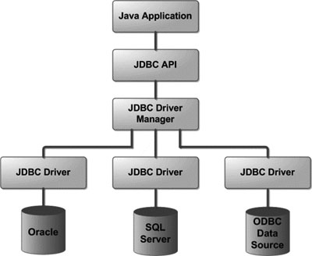
JDBC Architecture(2)
This is the architectural diagram that shows the location of the driver manager with respect to the JDBC drivers and the Java application:

Slide 8
Common JDBC components
2

Slide 9
Common JDBC components(1)
You should know the following interfaces and classes from JDBC API:
Driver Manager-class
Driver-interface
Connection-interface
Statement-interface
ResultSet-interface
SQLException-class
Notes:
Driver Manager ➔The first driver that recognizes a certain subprotocol under JDBC will be used to establish a database Connection.

Slide 10
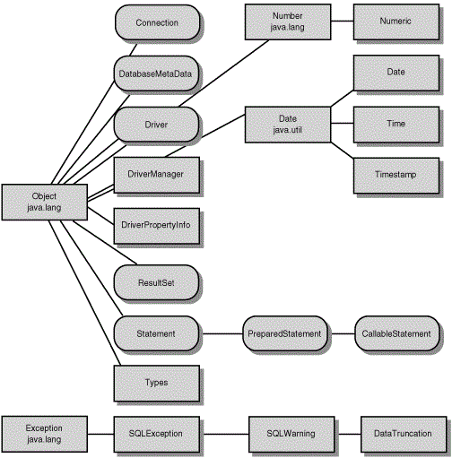
Common JDBC components(2)
Notes:
Driver Manager ➔The first driver that recognizes a certain subprotocol under JDBC will be used to establish a database Connection.

Slide 11
Environment configuration
3

Slide 12
Environment configuration
Make sure you have done following setup:
Core JAVA Installation
SQL or MySQL Database Installation (e.g. Oracle 11g Database )
Install database driver (e.g. ojdbc6 for Oracle database)
Set database credentials (user ID and password)
Create database
Create tables

Slide 13
Creating JDBC application
4

Slide 14
Creating JDBC application
Import the packages
e.g. import java.sql.*
2) Register the JDBC driver
3) Open a connection
DriverManager.getConnection()
4) Execute a query
5) Extract data from result set
ResultSet.getXXX()
6) Clean up the environment

Slide 15
JDBC Drivers
5

Slide 16
What is a JDBC Driver?
JDBC drivers implement the defined interfaces in the JDBC API for interacting with your database server.
For example, using JDBC drivers enable you to open database connections and to interact with it by sending SQL or database commands then receiving results with Java.

Slide 17
Driver Types
JDBC driver implementations vary because of the wide variety of operating systems and hardware platforms in which Java operates. Sun has divided the implementation types into four categories:
Type 1: JDBC-ODBC Bridge Driver
Type 2: JDBC-Native API
Type 3: JDBC-Net pure Java
Type 4: 100% pure Java

Slide 18
Which driver should we use?
If you are accessing one type of database, such as Oracle, Sybase, or IBM, the preferred driver type is 4.
If your Java application is accessing multiple types of databases at the same time, type 3 is the preferred driver.
Type 2 drivers are useful in situations where a type 3 or type 4 driver is not available yet for your database.
The type 1 driver is not considered a deployment-level driver and is typically used for development and testing purposes only.

Slide 19
Type 4: 100% pure Java
In a Type 4 driver, a pure Java-based driver that communicates directly with vendor's database through socket connection.
This is the highest performance driver available for the database and is usually provided by the vendor itself.
This kind of driver is extremely flexible, you don't need to install special software on the client or server. Further, these drivers can be downloaded dynamically.

Slide 20
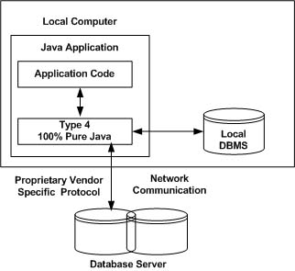
Type 4: 100% pure Java

Slide 21
Register JDBC Driver
You must register the driver in your program before you use it.
Registering the driver is the process by which the Oracle driver's class file is loaded into memory so it can be utilized as an implementation of the JDBC interfaces.
You need to do this registration only once in your program. You can register a driver in one of two ways.

Slide 22
First approach
Use Java's Class.forName() method :
try {
Class.forName("oracle.jdbc.driver.OracleDriver");
}
catch(ClassNotFoundException ex) {
System.out.println("Error: unable to load driver class!");
System.exit(1);
}

Slide 23
Second approach
Use DriverManager.registerDriver() :
try {
Driver myDriver = new oracle.jdbc.driver.OracleDriver();
DriverManager.registerDriver( myDriver );
}
catch(ClassNotFoundException ex) {
System.out.println("Error: unable to load driver class!");
System.exit(1);
}

Slide 24
Connection
6

Slide 25
Static connection(1)
After you have loaded the driver you can establish a connection.
You can use DriverManager.getConnection() method.
There are three overloaded methods by which you can get a connection:
getConnection(String url)
getConnection(String url, Properties prop)
getConnection(String url, String user, String password)
URL example for Oracle:
jdbc:oracle:thin:@hostname:port Number:databaseName

Slide 26
Static connection(2)
String URL = "jdbc:oracle:thin:@localhost:1521:EMP";
String USER = "username";
String PASS = "password“;
Connection conn = DriverManager.getConnection(URL, USER, PASS);
String URL = "jdbc:oracle:thin:username/password@localhost:1521:EMP";
Connection conn = DriverManager.getConnection(URL);
String URL = "jdbc:oracle:thin:@amrood:1521:EMP";
Properties info = new Properties( );
info.put( "user", "username" );
info.put( "password", "password" );
Connection conn = DriverManager.getConnection(URL, info);

Slide 27
Dynamic connection(1)
Most of the times we are looking for loose coupling for connectivity so that we can switch databases easily, connection pooling for transaction management and distributed systems support.
In order to achieve that, JDBC DataSource is the preferred approach.
JDBC DataSource interface is present in javax.sql package and it only declare two overloaded methods:
getConnection()
getConnection(String username, String password)

Slide 28
Dynamic connection(2)
It is the responsibility of different Database vendors to provide different kinds of implementation of DataSource interface.
Oracle database driver implements it with:
oracle.jdbc.pool.OracleDataSource class.
These implementation classes provide methods through which we can provide database server details with user credentials:
oracleDS.setURL(props.getProperty("ORACLE_DB_URL"));
oracleDS.setUser(props.getProperty("ORACLE_DB_USERNAME"));
oracleDS.setPassword(props.getProperty("ORACLE_DB_PASSWORD"));

Slide 29
Advantages
Because of its properties, a DataSource object is a better alternative than the DriverManager class for getting a connection.
Programmers no longer have to hard code the driver name or JDBC URL in their applications, which makes them more portable.
Also, DataSource properties make maintaining code much simpler.

Slide 30
Closing the connection
It is a good programming practice to close the connection using close() method at the end of your JDBC program.

Slide 31
Statement
7

Slide 32
Statement types
Statement interfaces define the methods and properties that enable you to send SQL or PL/SQL commands and receive data from your database.
You should know that there are three types of statements:
Statement
PreparedStatement
CallableStatement

Slide 33
Which interface to use ?
Statement
Use for general-purpose access to your database. Useful when you are using static SQL statements at runtime. It cannot accept parameters.
PreparedStatement
Use when you plan to use the SQL statements many times. The PreparedStatement interface accepts input parameters at runtime.
Callable Statement
Use when you want to access database stored procedures. The CallableStatement interface can also accept runtime input parameters.

Slide 34
Statement(1)
Before you can use a Statement object to execute a SQL statement, you need to create one using the Connection object's createStatement() method:
Statement stmt = null;
try {
stmt = conn.createStatement( );
. . .
}
catch (SQLException e) {
. . .
}
finally {
. . .
}

Slide 35
Statement(2)
Once you've created a Statement object, you can then use it to execute a SQL statement with one of its three execute methods:
boolean execute(String SQL)
Returns a boolean value of true if a ResultSet object can be retrieved; otherwise, it returns false.
int executeUpdate(String SQL)
Returns the numbers of rows affected by the execution of the SQL statement.
ResultSet executeQuery(String SQL)
Returns a ResultSet object.

Slide 36
Statement(3)
Just as you close a Connection object to save database resources, for the same reason you should also close the Statement object.
Statement stmt = null;
try {
stmt = conn.createStatement( );
. . .
}
catch (SQLException e) {
. . .
}
finally {
stmt.close();
}aaa

Slide 37
PreparedStatement(1)
This interface extends the Statement interface and gives you the flexibility of supplying arguments dynamically.
PreparedStatement pstmt = null;
try {
String SQL = "Update table_name SET column1 = ? WHERE column2 = ?";
pstmt = conn.prepareStatement(SQL);
. . .
}
catch (SQLException e) {
. . .
}
finally {
pstmt.close();
}

Slide 38
PreparedStatement(2)
All parameters in JDBC are represented by the ? symbol, which is known as the parameter marker.
You must supply values for every parameter before executing the SQL statement.
The setXXX() methods bind values to the parameters, where XXX represents the Java data type of the value you wish to bind to the input parameter.
pstmt.setNString(parameter_number,parameter_value);
All of the Statement object's methods for interacting with the database also work with the PreparedStatement object.

Slide 39
CallableStatement
CallableStatement object would be used to execute a call to a database stored procedure.
CallableStatement cstmt = null;
try {
String SQL = "{call getEmpName (?, ?)}";
cstmt = conn.prepareCall (SQL);
. . .
}
catch (SQLException e) {
. . .
}
finally {
. . .
}

Slide 40
ResultSet
8

Slide 41
ResultSet
The SQL statements that read data from a database query return the data in a result set.
The java.sql.ResultSet interface represents the result set of a database query.
A ResultSet object maintains a cursor that points to the current row in the result set. The term "result set" refers to the row and column data contained in a ResultSet object.

Slide 42
ResultSet(1)
JDBC provides following connection methods to create statements with desired ResultSet:
createStatement(int RSType, int RSConcurrency);
prepareStatement(String SQL, int RSType, int RSConcurrency);
prepareCall(String sql, int RSType, int RSConcurrency);

Slide 43
ResultSet Types
ResultSet.TYPE_FORWARD_ONLY
The cursor can only move forward in the result set.
ResultSet.TYPE_SCROLL_INSENSITIVE
The cursor can scroll forwards and backwards.
The result set is not sensitive to changes made by others to the database.
ResultSet.TYPE_SCROLL_SENSITIVE
The cursor can scroll forwards and backwards.
The result set is sensitive to changes made by others to the database.
Default, the result set is TYPE_FORWARD_ONLY.

Slide 44
ResultSet concurrency
ResultSet.CONCUR_READ_ONLY
Creates a read-only result set. This is the default.
ResultSet.CONCUR_UPDATABLE
Creates an updateable result set.

Slide 45
ResultSet methods
Navigational methods: used to move the cursor around.
Get methods: used to view the data in the columns of the current row being pointed to by the cursor.
Update methods: used to update the data in the columns of the current row. The updates can then be updated in the underlying database as well.

Slide 46
Navigating a ResultSet
There are several methods in the ResultSet interface that involve moving the cursor, including:
public boolean first() throws SQLException
public boolean last() throws SQLException
public boolean absolute(int row) throws SQLException
public boolean relative(int row) throws SQLException
public boolean previous() throws SQLException
public boolean next() throws SQLException
public int getRow() throws SQLException

Slide 47
Viewing a ResultSet
There is a get method for each of the possible data types, and each get method has two versions:
public int getInt(String columnName) throws SQLException
Returns the int in the current row in the column named columnName
public int getInt(int columnIndex) throws SQLException
Returns the int in the current row in the specified column index.

Slide 48
Updating a ResultSet(1)
As with the get methods, there are two update methods for each data type:
public void updateString(int columnIndex, String s) throws SQLException
Changes the String in the specified column to the value of s.
public void updateString(String columnName, String s) throws SQLException
Similar to the previous method, except that the column is specified by its name instead of its index.

Slide 49
Updating a ResultSet(2)
Updating a row in the result set changes the columns of the current row in the ResultSet object, but not in the underlying database.
To update your changes to the row in the database, you need to invoke one of the following methods:
public void updateRow()
public void deleteRow()
public void refreshRow()
public void cancelRowUpdates()
public void insertRow()

Slide 50
Data types
9

Slide 51
Data types(1)
The JDBC driver converts the Java data type to the appropriate JDBC type before sending it to the database.
It uses a default mapping for most data types.
For example, a Java int is converted to an SQL INTEGER.
Default mappings were created to provide consistency between drivers.

Slide 52
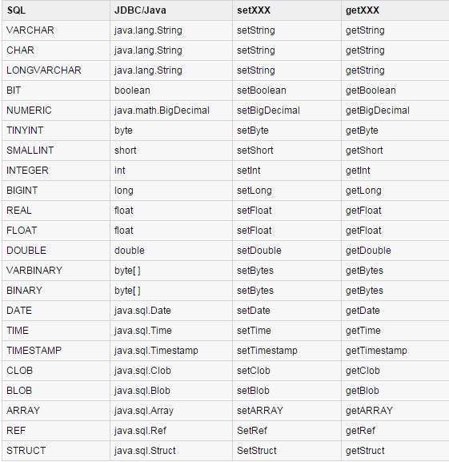
Data types(2)

Slide 53
Transactions
10

Slide 54
Transactions(1)
Transactions enable you to control if, and when, changes are applied to the database.
It treats a single SQL statement or a group of SQL statements as one logical unit, and if any statement fails, the whole transaction fails.

Slide 55
Transactions(2)
To enable manual- transaction support instead of the auto-commit mode that the JDBC driver uses by default, use the Connection object's setAutoCommit() method.
con.setAutoCommit(false);

Slide 56
Commit & Rollback
Once you are done with your changes and you want to commit the changes then call commit() method on connection object as follows:
con.commit( );
Otherwise, to roll back updates to the database made using the Connection named conn, use the following code:
con.rollback();

Slide 57
Using savepoints(1)
Most modern DBMS support savepoints within their environments such as Oracle's PL/SQL.
When you set a savepoint you define a logical rollback point within a transaction.
If an error occurs past a savepoint, you can use the rollback method to undo either all the changes or only the changes made after the savepoint.

Slide 58
Using savepoints(2)
The Connection object has two new methods that help you manage savepoints:
setSavepoint(String savepointName)
releaseSavepoint(Savepoint savepointName)
There is one rollback ( String savepointName ) method which rolls back work to the specified savepoint.

Slide 59
Exceptions Handling
11

Slide 60
Exceptions
When an exception condition occurs, an exception is thrown.
The term thrown means that current program execution stops, and control is redirected to the nearest applicable catch clause.
JDBC Exception handling is very similar to Java Exception handling but for JDBC, the most common exception you'll deal with is java.sql.SQLException.

Slide 61
SQLException methods
A SQLException can occur both in the driver and the database.
The passed SQLException object has the following methods available for retrieving additional information about the exception:
getErrorCode( )
getMessage( )
getSQLState( )
getNextException( )
printStackTrace( )

Slide 62
JDBC best practices
12

Slide 63
Best Practice #1
Use PreparedStatement in order to avoid SQLinjection

Slide 64
Best Practice #2
Use ConnectionPool

Slide 65
Best Practice #3
Disable auto commit mode

Slide 66
Best Practice #4
Access ResultSet using column name to avoid InvalidColumnIndexError

Slide 67
Best Practice #5
Use Bind variables(?) instead of String concatenation

Slide 68
Best Practice #6
Always close Statement, PreparedStatement and Connection

Slide 69
Best Practice #7
Choose suitable JDBC driver for your application

Slide 70
Best Practice #8
Use standard SQL statement and avoid using db specific query until necessary

Slide 71
Best Practice #9
Use correct getXXX() method

Slide 72
Thank you!

Slide 73
Questions?

